Slide 1

Minimizing Contractor Reliance & Credit Purchases to Strengthen Direct Customer Relationship & Improve Cash Flow in a
Plywood & Interior Materials Business
Project Presentation
Background
Introduction
Problem Statement
Business Database Management | Capstone Project
Vaibhav Satish | 21f3002068
IITM Online BS Degree Program, Indian Institute of Technology, Madras, Chennai, Tamil Nadu, India
22nd Nov, 2025

Slide 2



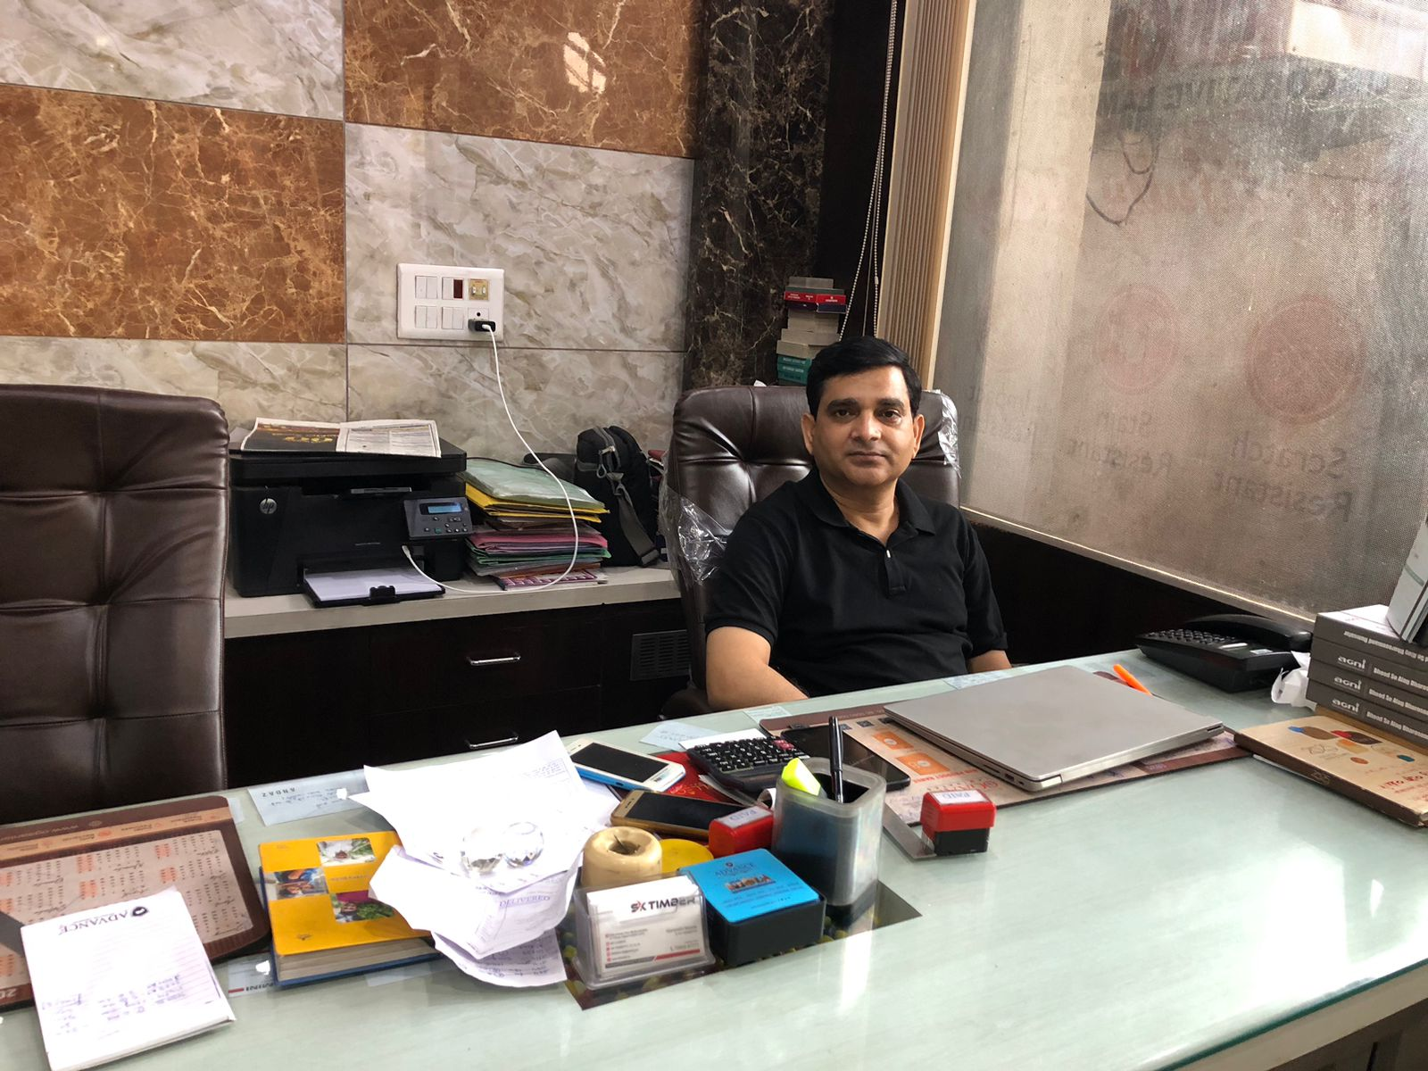
Organization Background
Md. Aslam
Background
Problem Statement
Data Collection
Analysis
S.K. Timber | Since 2000
Etah Chungi, Near Medha Hospital, Aligarh, Uttar Pradesh, India, 202001
Proprietor @SK Timber
Regional distributor of plywood and interior materials | 300+ items
Hybrid model leveraging a network of 600+ informal contractors and direct End Customers (ECs) along with some B2B interaction.
Quality Products
Fair Pricing
Deep Industry Expertise
Figure1: Picture of the business owner Mohammad Aslam in his office @SK Timber

Slide 3

Problem Statement
Data Collection
Analysis
Findings
Framing the Problem by Assessing the Current State of Business
01
03
Current scenario is such that “Maintaining good relationship with contractors is much important than direct customer.”
LATENT CREDIT RISK EXPOSURE
Limiting The Cash Flow
Analyze existing credit practices to uncover the true credit exposure and
suggest data-backed credit management processes.
Data reveals more and deeper issues.
CONTRACTOR OVERRELIANCE
Threatening EC Relations
SEASONAL DEMAND VOLATILITY Disrupting Inventory Planning
02
Identify seasonality patterns and assess inventory turnover rates to propose stock optimization
strategies aligned with demand cycles.
Enhance direct customer relationship by optimizing the contractor reliance
Oh…

Slide 4





Data Collection
Analysis
Findings
Recommendations
What Data to Collect ?
SALES
PURCHASE
Contractor Performance Data
(A-List Only | 67 Individuals)
Sales FY25
INVOICES
Purchase FY25
INVOICES
EC ESTIMATE MEMOS
B2B (8)
B2C (9)
Purchase (11)
Inventory Data
(DERIVED)
Contractor Driven (9)
Organic Customers (9)

Slide 5
Analysis
Findings
Recommendations
Analysis SUite 1
Diagnose Channel Profitability and Structural Risk in the
Contractor-Influenced End-Customer Sales
Analysis SUitE 1
Analysis SUitE 3
Diagnose Seasonal Demand Volatility by Designing Segment-Level
Demand Stability Scorecard
Stress Test the Fragility
Analysis SUite 3
Contribution Analysis & Lorenz Curve
Sales Breakdown by Payment Method and Buyer Role
Attrition Risk Model
Channel Mix Simulation
Analysis SUitE 2
Analysis SUitE 2
Diagnose Contractor Network Fragility and Revenue Concentration
Risk within Top Performing Contractors (A-List)
Lightweight Credit Risk Assessment via Payment Behavior and
Cashflow Stress Indicators
Volatility Assessment (CV & MAD)
Analysis SUitE 4
ANOVA Test for Segment Profitability
Time Series Pattern Detection (ACF)
Monte Carlo simulation
Demand Stability Scorecard
Responsive Inventory Optimization
ANOVA Test Re-Run
Seasonality-Aware EOQ Modeling

Slide 6
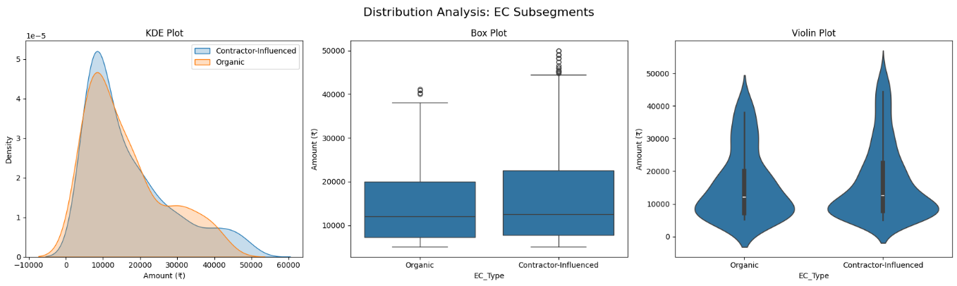
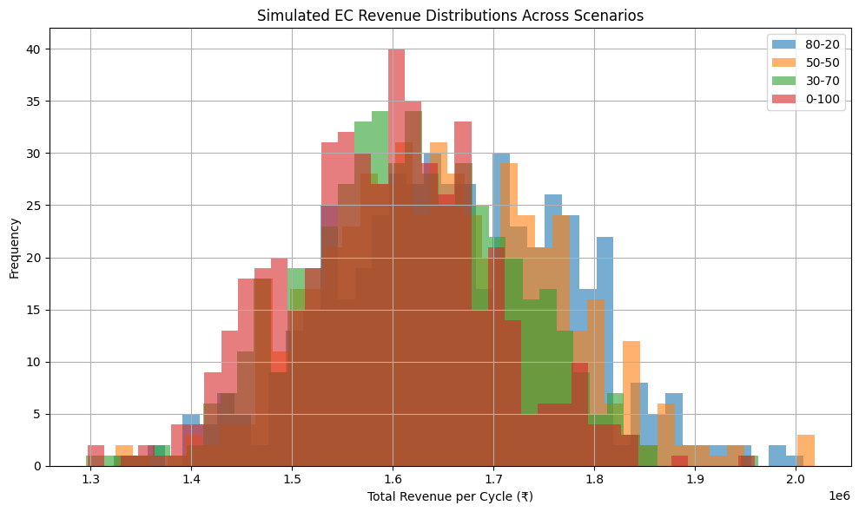
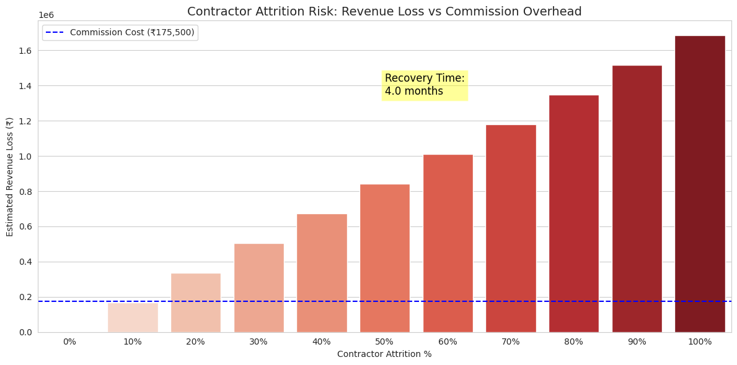
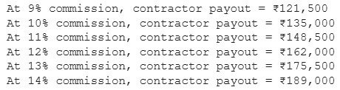

Findings
Recommendations
Subsequent segmentation revealed that contractor-mediated sales disproportionately drove the uplift of end customer average order value (AOV)
Figure 3 [a], [b], & [c]: Kernel Density Plot, Box Plot, and Violin Plot for EC Sub Segmentation Distribution Analysis
Figure 2: Simulated EC Revenue Distributions Across Scenarios
Moving from 80% to 0% contractor-influenced ECs causes a drop of nearly ₹67K per sales cycle
(₹16.64L → ₹15.97L). That’s ~4% loss in top-line
EC revenue per 100 transactions.
Figure 4 [a], [b], & [c]: Bar Chart visualizing Contractor Attrition Risk: Revenue Loss vs Commission Overhead, Commission Overhead, and Recovery Timeline
Rebuilding the lost transaction volume through organic end-customer acquisition would require an estimated four months.

Slide 7
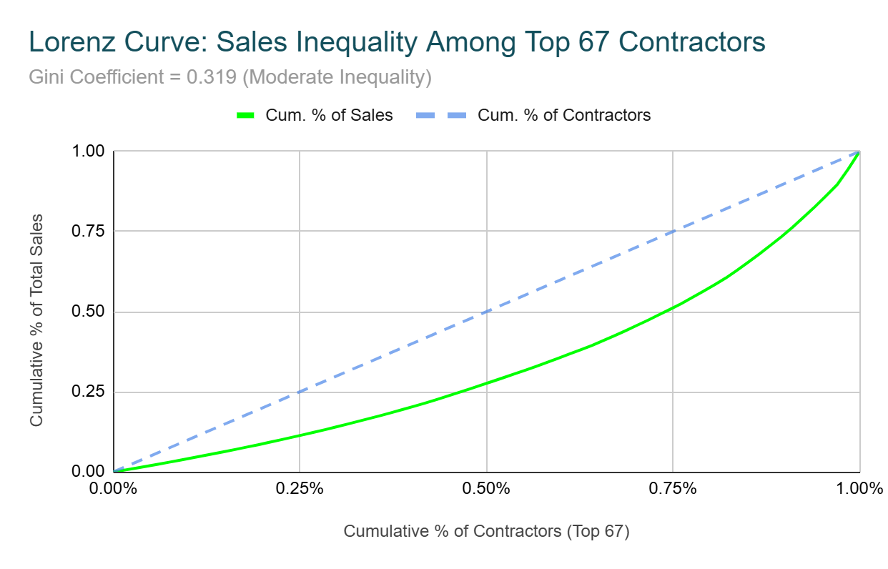
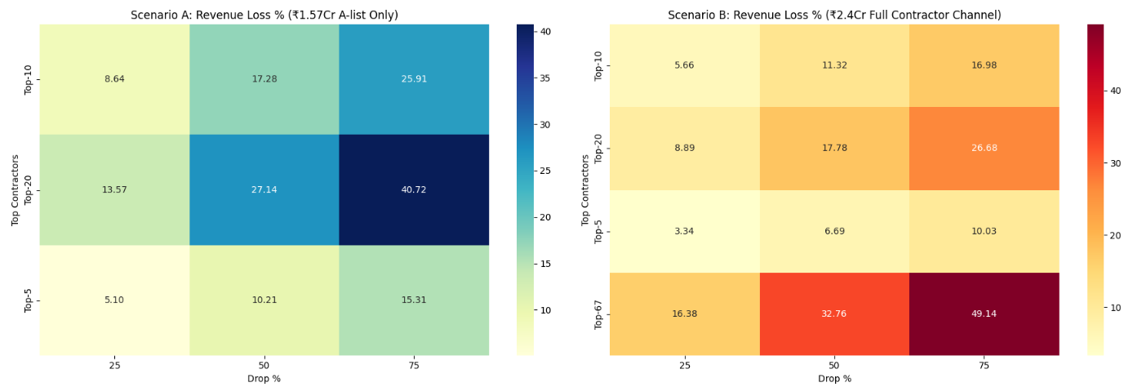
Findings
Recommendations
Despite having a seemingly high CDI (0.978), the top 5–20 contractors are disproportionately contributing to revenue, exposing a structural fragility beneath the surface of a “diverse” A-list. This was evident in the Lorenz Curve
Gini = 0.329
Figure 3.2.1 [a]: Visualizing Sales Inequality in A-List using Lorenz Curve
Top N Contractors Removed | Revenue Lost (₹) | % of A-list Revenue
Top 5 | ₹32,10,865 | 20.30%
Top 10 | ₹54,33,048 | 34.35%
Top 20 | ₹85,36,505 | 53.98%
Remaining 47 Contractors | ₹65,96,496 | 41.95%
Total (A-list) | ₹1,57,24,614 | 100.00%
Figure 3.2.1 [b] & [c]: Visualizing Sales Inequality in A-List using Lorenz Curve Sensitivity Analysis of Contractor Channel: Simulated Revenue Impact Under Partial Attrition Scenarios (A-List and Combined estimate of A, B, and C list)

Slide 8
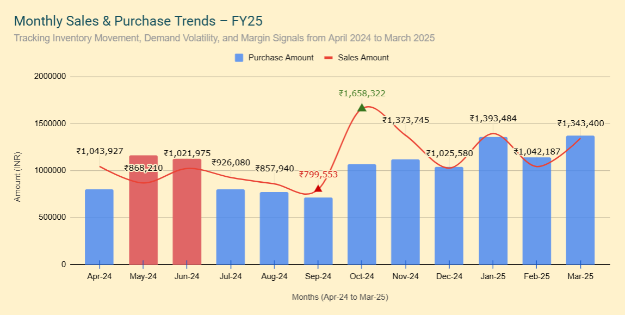
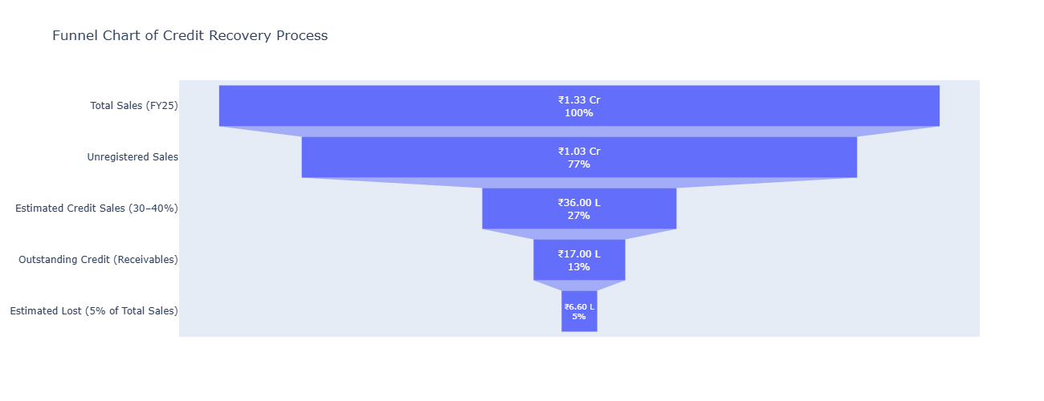
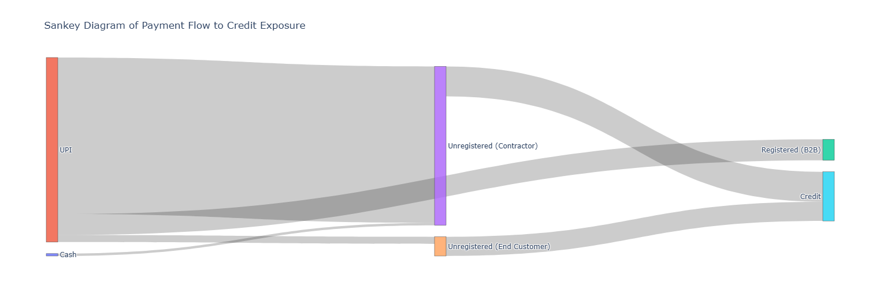
Findings
Recommendations
Segment | Stability Index A (Inventory Focus) | Stability Index B (Channel Predictability)
B2B | 26.52 | 14.68
Contractor | 100.00 | 100.00
End Customer | 16.07 | 16.86
Table 2.4.2.3 [d]: Composite Demand Stability Indices by Segment (Inventory vs. Channel Perspective)
Figure 3.4.1: FY25 Inventory Dynamics: Sales vs. Purchase Trends (Apr 2024 – Mar 2025)
Figure 2.2 [a] & [b]: Quantifying Financial Leakage in the Credit Recovery Process and Tracing Financial Risk through Payment Flows

Slide 9
Findings
Recommendations
Risk Prioritization Using Failure Mode and Effects Analysis (FMEA)
Failure Mode | S | O | D | RPN | Notes / Impact
Loss of top 20 contractors | 9 | 7 | 5 | 315 | ~49% of contractor-driven revenue at risk; long recovery time (4+ months)
Rising credit defaults from ECs | 8 | 6 | 4 | 192 | ₹16–18L in receivables stuck; affects cash flow and liquidity
Seasonal overstocking | 7 | 5 | 4 | 140 | Excess stock peaked at 148%; high holding costs, low turnover
Inventory misalignment due to demand lag | 6 | 6 | 3 | 108 | Procurement in March ignored low sales, triggering waste
Contractor disengagement (non-A-list) | 5 | 5 | 5 | 125 | Reduced redundancy in the contractor channel undermines future resilience
Delayed detection of churn risk | 6 | 4 | 6 | 144 | Annual reviews are too slow; churn could’ve been prevented via monthly tracking
Table 3: FMEA Summary Table: The highest risk (RPN 315) is over-reliance on top contractors, highlighting the need for retention mechanisms and diversification.

Slide 10
Interpretations & Recommendations
Recommendations
INTERPRETATIONS
RECOMMENDATIONS
Contractors Are High-Leverage Enablers, But Operationally Fragile
Seasonal Blindness and the Case for EOQ Optimization
Change contractor contracts so they’re rewarded for customer satisfaction, not just task completion.
Initiate formal Service Level Agreements (SLAs) or tier-based loyalty programs for contractors like ABHISHEK, RAJKUMAR, BABLU SHARMA, DURGESH JI, and others in the top 10–20 individuals.
Replace the current annual review process (during Diwali bonuses rollout) with monthly reviews to track churn risk and preempt disengagement.
Structural risks present solely in Unregistered Sales (Mostly ECs)
Focus on rebalancing the contractor lists by targeting onboarding from B/C-list contractors while keeping retention efforts to only A-List.
The EC Segment Is the Strategic Profit Engine
Integrate promo codes, cashback offers, and fast-delivery benefits on the official digital sales platform to attract organic customers.
Replace the current annual review process (during Diwali bonuses rollout) with monthly reviews to track churn risk and preempt disengagement.
Use channel-mix targets by aiming to first gradually lower the contractor-influenced EC sales to 50-60% by Q3 FY26 and set quarterly reviews to rebalance.
Retaining Contractors is Costly, Losing Them is Costlier
Contractor Impact is Systemic, Not Just Commercial

